Slide 1
Special Member Function
Rule of Three, Five, Zero and Five Defaults

Slide 2
Terminology
“deleted” - generated or declared with = delete; - deleted members participate in overload resolution
“not declared” - do not generated and do not participate in overload resolution.
“defaulted” - generated by compiler or declared with = default;
“disables” - either deleting or not declaring something
“copy/move operation” - copy/move assignment and construction
“user declared” - can be deleted, defaulted or user-defined

Slide 3
What are the special member functions?
The special member functions are the ones that C++ is willing to generate on its own.
C++98 has four such functions: the default constructor, the destructor, the copy constructor, and the copy assignment operator.
C++11 adds two more - the move constructor and the move assignment operator.

Slide 4
What are the special member functions?
default constructor destructor copy constructor copy assignment move constructor move assignment
X(); ~X(); X(X const&); X& operator=(X const&); X(X&&); X& operator=(X&&);

Slide 5
What are the special member functions?
These functions are generated only if they’re needed, i.e., if some code uses them
only if something illegal does not happen
If copy/move operations are generated they perform “memberwise copies/moves” on the non-static data members of the class.
They are inline and public. Destructor is virtual if base class destructor is virtual

Slide 6
Default constructor
Generated only if the class contains no user-declared constructors
not declared if any other constructor is declared including move and copy constructors

Slide 7
What declaring a default constructor disables?
Nothing
Declaring a default constructor does not imply resource ownership

Slide 8
Destructor
inline public member
virtual only if a base class destructor is virtual
=delete; if has a non-static or has a direct or virtual base class that can not be destructed (has deleted or inaccessible destructor)

Slide 9
What declaring the destructor disables?
move constructor and move assignment are not declared
copy constructor and copy assignment are declared but it's deprecated

Slide 10
Copy operations
memberwise copy construction/assignment of non-static data members.
Generated only if the class lacks a user declared the other copy operation.
Deleted if the class declares a move operation
Generation of this functions in a class with a user-declared copy operation operator or destructor is deprecated.

Slide 11
What declaring the copy operations disables?
default constructor is not declared
the other copy operation is declared but it's deprecated
move operations are not declared and if requested will be replaced with copy operations

Slide 12
Move operations
Generated only if the class contains no user declared
copy operations
move operations
destructor

Slide 13
What declaring a move operation disables?
deletes copy operations
the other move operation is not declared

Slide 14
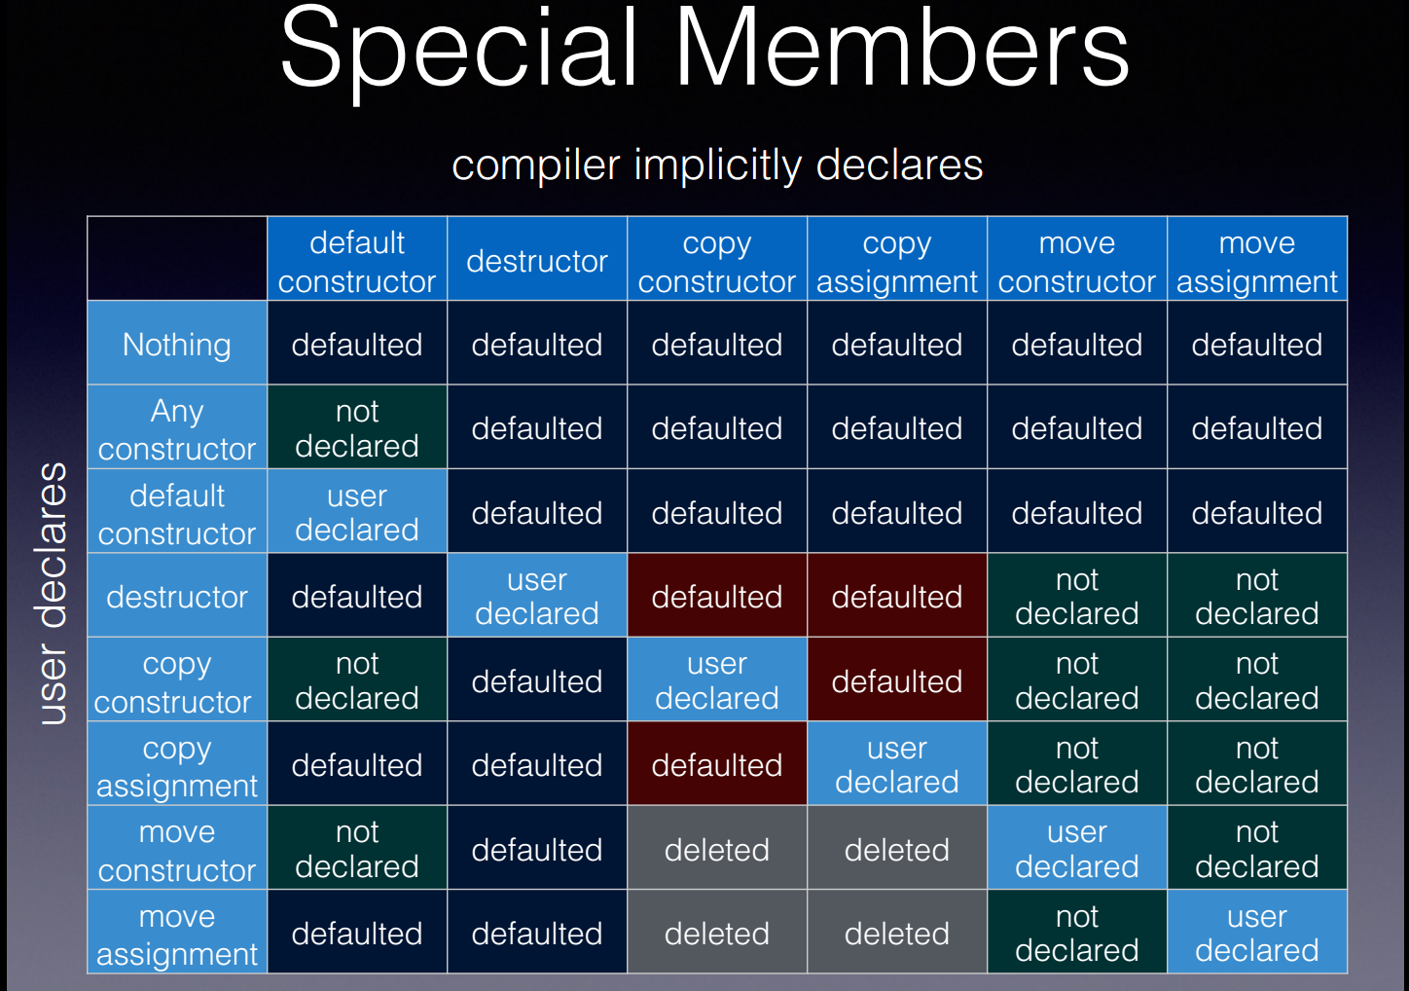
http://accu.org/content/conf2014/Howard_Hinnant_Accu_2014.pdf

Slide 15
Rule of Three (C++98/03)
If a class requires a user-defined destructor, a user-defined copy constructor, or a user-defined copy assignment operator it almost certainly requires all three.

Slide 16
Rule of Five (C++11)
If a class requires destructor, move or copy operation it almost certainly requires all five of them.

Slide 17
Rule of Zero
Classes that have custom destructors, copy/move constructors or copy/move assignment operators should deal exclusively with ownership. Other classes should not have custom destructors, copy/move constructors or copy/move assignment operators.
Rule of Zero

Slide 18
Rule of five defaults
Always declare destructor, move and copy operations as =default;
A Concern about the Rule of Zero

Slide 19
Special Member Function
Thank you

